Slide 1
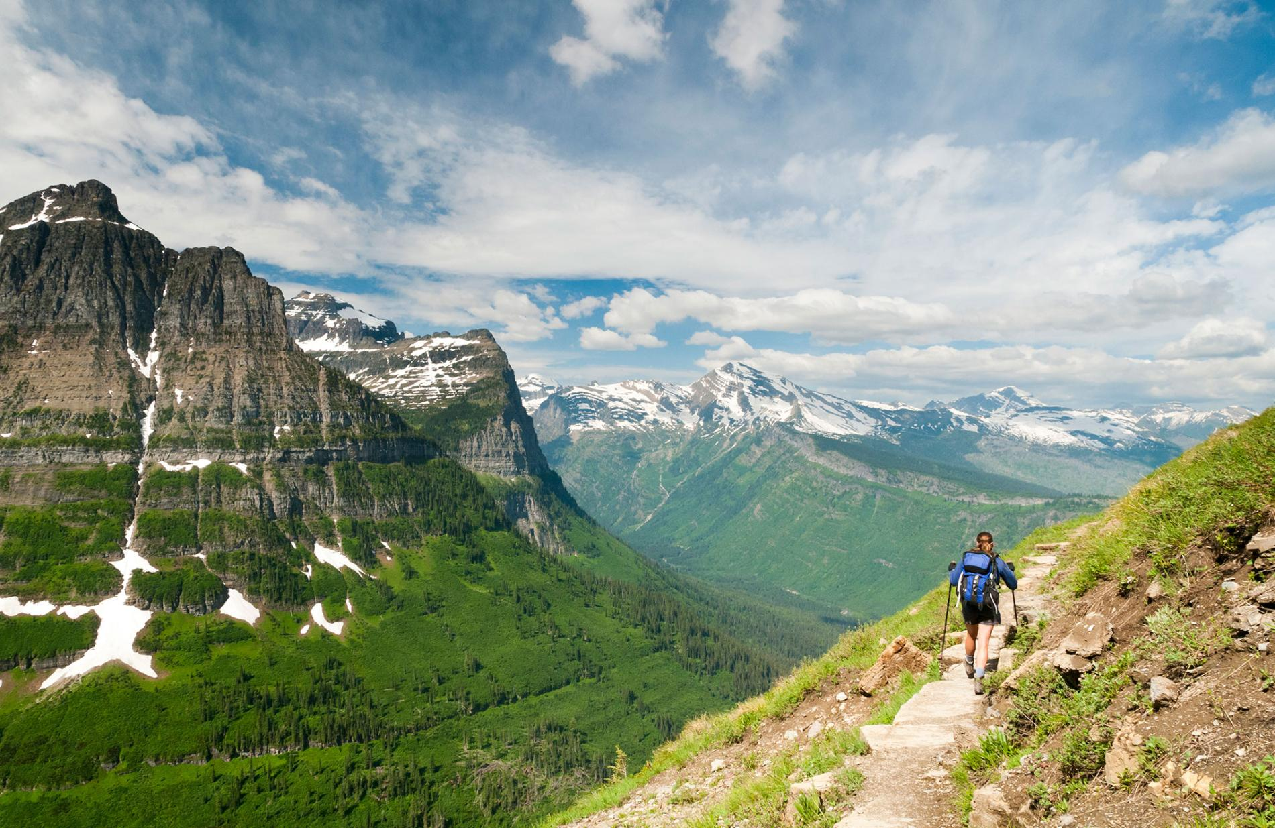
DATE-a-PARK

